Slide 1
Lecture 4-1 Introduction to Zynq, Zybo, Vivado, Lab #3-1
Xilinx vs. Altera (Intel)
ECE530 Course Objectives and Schedule
Prerequisites and Platform Support
Hardware and Software Codesign with Zynq
The Zynq-7000 AP SoC Chip architecture
The Zybo Board and Zynq 7000 Chip
Xilinx University Program: Embedded Systems Development using Zynq
The First Five Labs from Xilinx University Program: Embedded Systems Development using Zynq
Altera’s Cyclone V SoC
Labs #3 Part 1

Slide 2
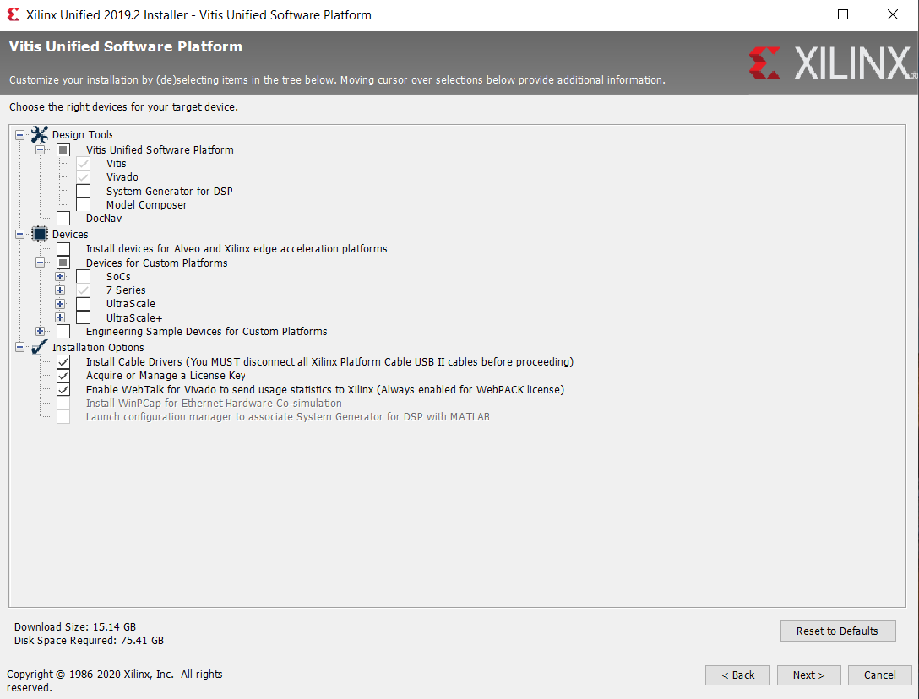
Xilinx Unified 2019.2 Installer Requires 75.42 GB of Disk Space
2019.2 Version of Vivado and Vitis core require 75 GB of disk space

Slide 3

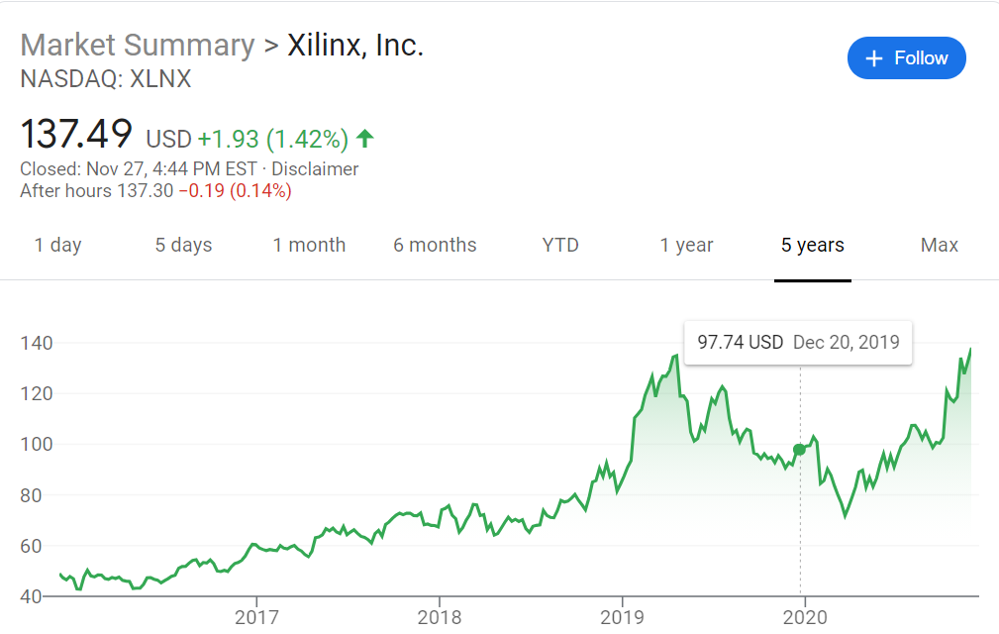
Xilinx SoC FPGA Powers Baidu’s Apollo Driverless Platform (Jan 2, 2020)
Apollo, Baidu’s open-source platform for self-driving vehicles
Cloud Service Platform
Open software platform
Hardware Development Platform
Open Vehicle Certification Platform
Apollo Enterprise
Highway autonomous driving
Autonomous valet parking
Fully autonomous mini-busses
Xilinx Zynq Chip XAZU5EV-1SFVC784Q
https://www.electronicdesign.com/markets/automotive/article/21119589/xilinx-soc-fpga-powers-baidus-apollo-driverless-platform

Slide 4
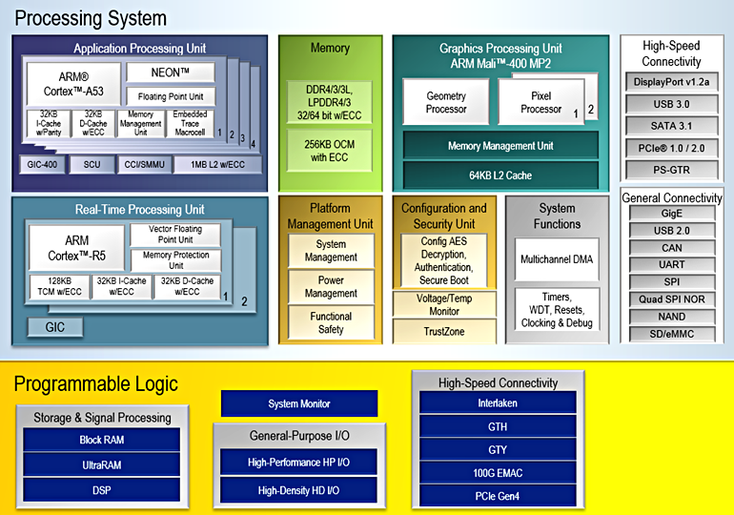
Xilinx SoC XAZU5EV-1SFVC784Q (Jan 2, 2020)
$2,954.46 at Digikey
1.2GHz 64-bit Quad Cortex A53
500 MHz Dual Cortex R5
400MHz MP2 GPU
500 MHz FPGA
256k logic cells
234k flip-flops
117k LUTs
5.1MB block RAM
1,248 DSP Slices
Digikey: https://www.digikey.com/product-detail/en/xilinx-inc/XAZU5EV-1SFVC784Q/122-XAZU5EV-1SFVC784Q-ND/10445682

Slide 5
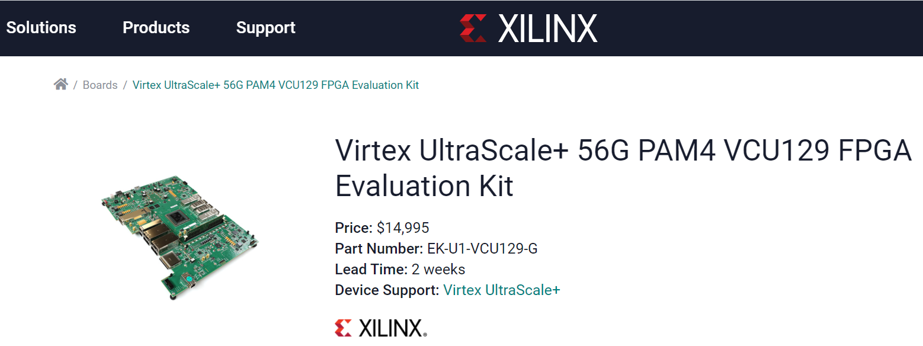
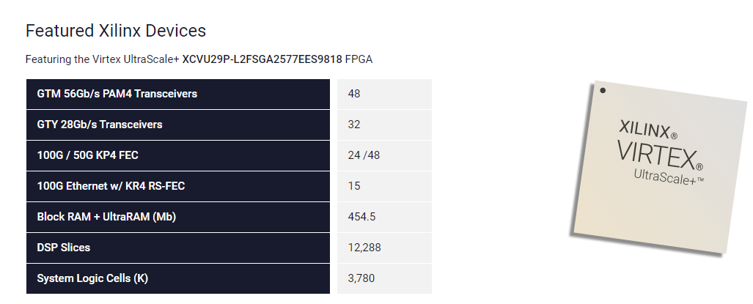
Price: $14,995
https://www.xilinx.com/products/boards-and-kits/vcu129.html

Slide 6
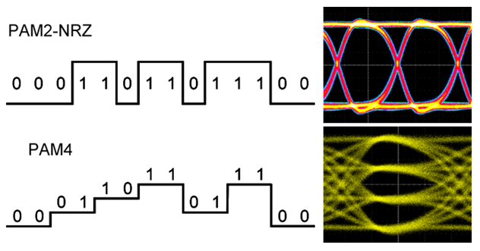
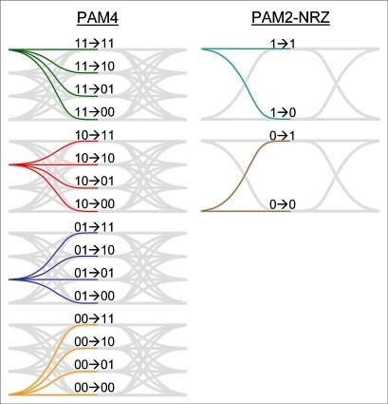
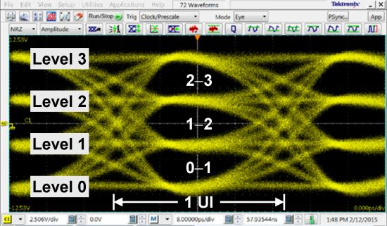
Time to Get Ready for PAM4! (https://www.tek.com/blog/time-get-ready-pam4)

Slide 7
56G PAM4 Technology
http://www.xilinx.com/products/technology/high-speed-serial/56g.html
Breaks through the physical limitations of data transmission at 50G+ line rates
PAM4 Modulation as the Way Forward
PAM4 (or 4-level Pulse Amplitude Modulation) has been recognized as the most scalable multi-level signaling protocol for next-generation line rates, and Xilinx is helping drive 56G PAM4 standardization efforts within both the Optical Internetworking Forum (OIF) and the Institute of Electrical and Electronics Engineers (IEEE).
Paving the Way Forward for Next Generation Ethernet
Cloud Computing, Industrial IoT, and Software-Defined Networks applications
Scale 50G, 100G, 400G ports, as well as terabit interfaces

Slide 8
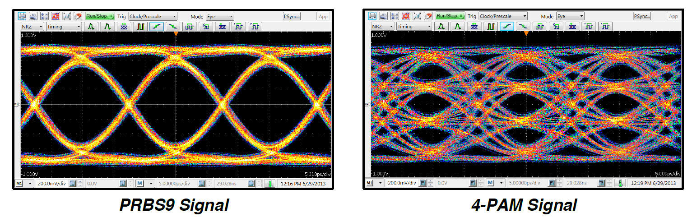
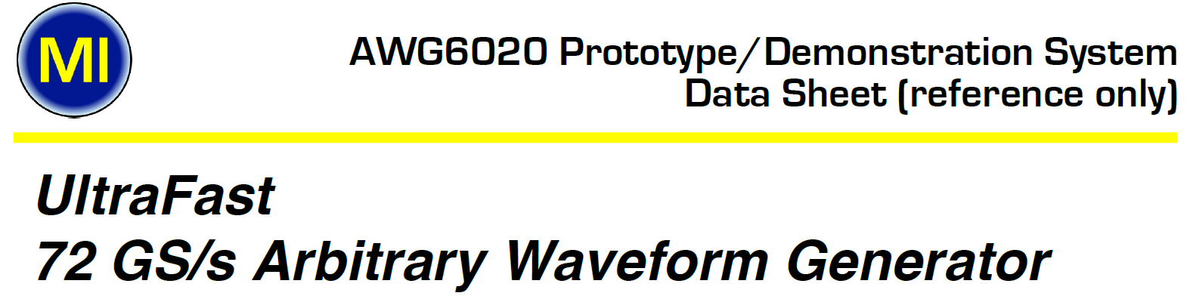
72 GS/s PAM 4 Signal Generator
PAM 4 Signal generated on AWG6020 with 72 GS/s Sample rate.
24 GH analog
(http://micram.net/wp-content/uploads/2014/11/AWG6020-Reference-Only-Data-Sheet-November-2014.pdf)

Slide 9

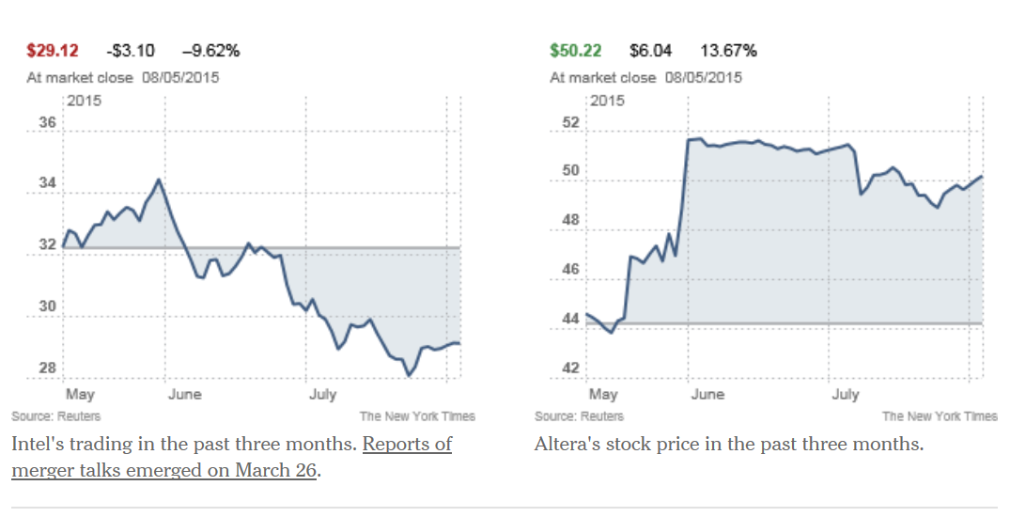
Intel buys Altera
for $16.7 Billions
June 1, 2015
Altera is Number 2 FPGA company in USA after Xilinx

Slide 10


AMD plans to buy Xilinx
for $35 Billions
October 27, 2020

Slide 11
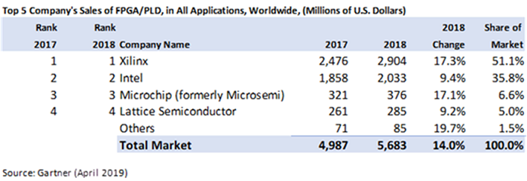
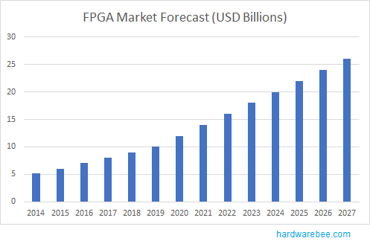
Top FPGA Companies For 2017-18 and FPGA market Forecast

Slide 12
Course Objectives
Introduce Xilinx Zybo Zynq-7000 ARM/FPGA SoC Trainer Board, Rev B
Introduce Xilinx Vivado Design Suite
Introduce Software Development Kit (SDK)
Introduce Concept of System on a Chip (SoC)
Introduce Hardware and Software Co-design
Create SoC embedded systems to utilize FPGA and ARM co-design
Linux Solution with Zynq-7000 All Programmable SoC

Slide 13
Prerequisites and Platform Support
Familiarity with the Xilinx tool set and design flow
Basic C programming
Basic understanding of processor-based system
Basic Verilog HDL knowledge
Vivado System Edition 2016.2
Xilinx University board – Zybo
Linux

Slide 14
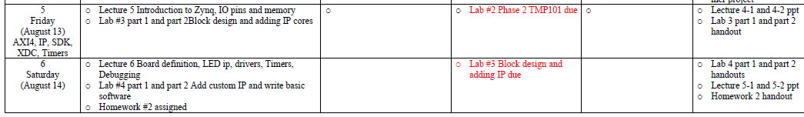
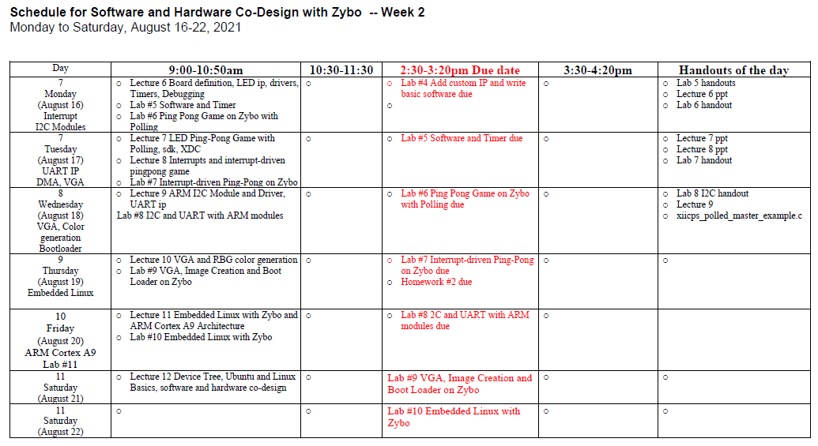

Slide 15
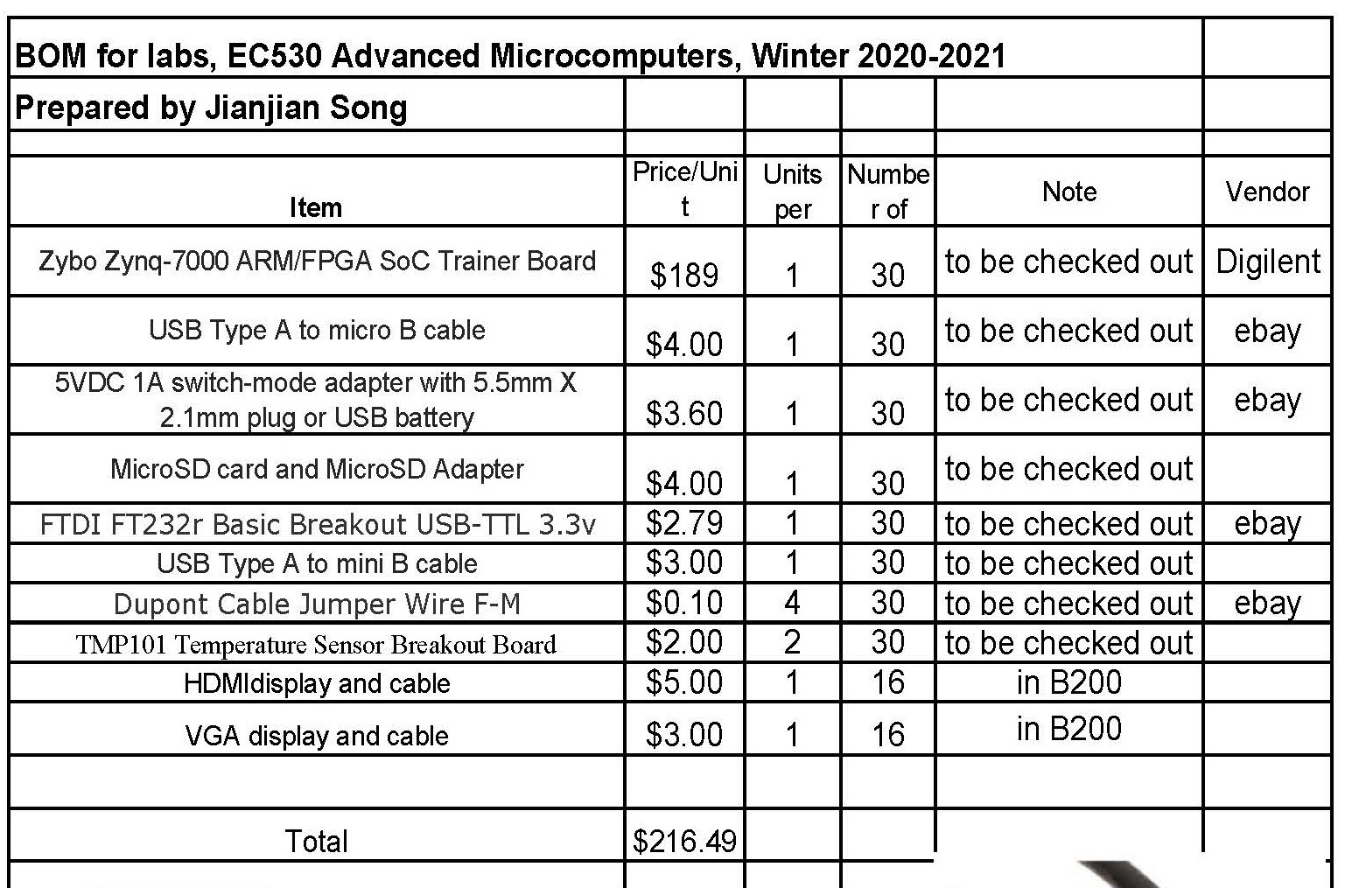

Slide 16
Distinct Features of Hardware and Software Design
 | Hardware | Software
Design Paradigm | Decomposition in space | Decomposition in time
Resource | Area (#gates, #Slices) | Time (#Cycles)
Flexibility | Must be designed in | Implicit
Parallelism | Implicit | Must be designed in
Modeling | Model ≠ Implementation | Model ≈ Implementation
Reuse | Uncommon | Common

Slide 17
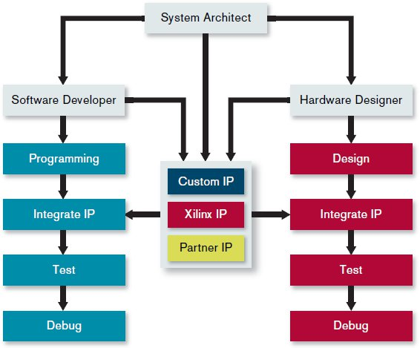
System Design Flow
Software
Hardware
Xilinx: Creating the Xilinx Zynq-7000 Extensible Processing Platform
Notes:
The Zynq-7000 Extensible Processing Platform relies on a familiar tool flow for system architects, software developers as well as hardware designers.

Slide 18
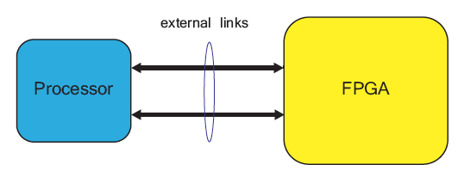
Traditional Discrete Component Architecture
Source: The Zynq Book

Slide 19
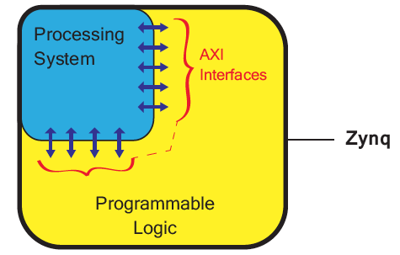
System on a Chip: the Zynq Chip Architecture
Source: The Zynq Book

Slide 20
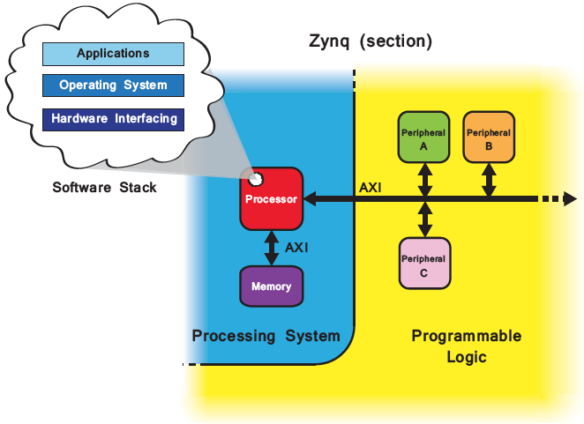
Mapping of an Embedded SoC Hardware Architecture to Zynq
Source: The Zynq Book

Slide 21
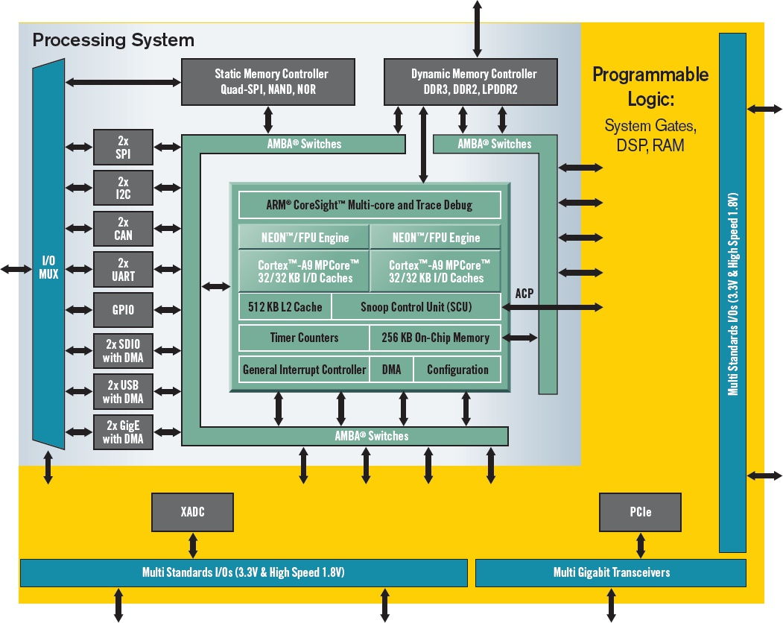
An Embedded SoC Hardware Architecture on Zynq Chip
Xilinx: Creating the Xilinx Zynq-7000 Extensible Processing Platform
Notes:
Figure 1. Unlike previous chips that combine MPUs in an FPGA fabric, Xilinx’s new Zynq-7000 Extensible Processing Platform device family lets the ARM processor, rather than the programmable logic, run the show.

Slide 22
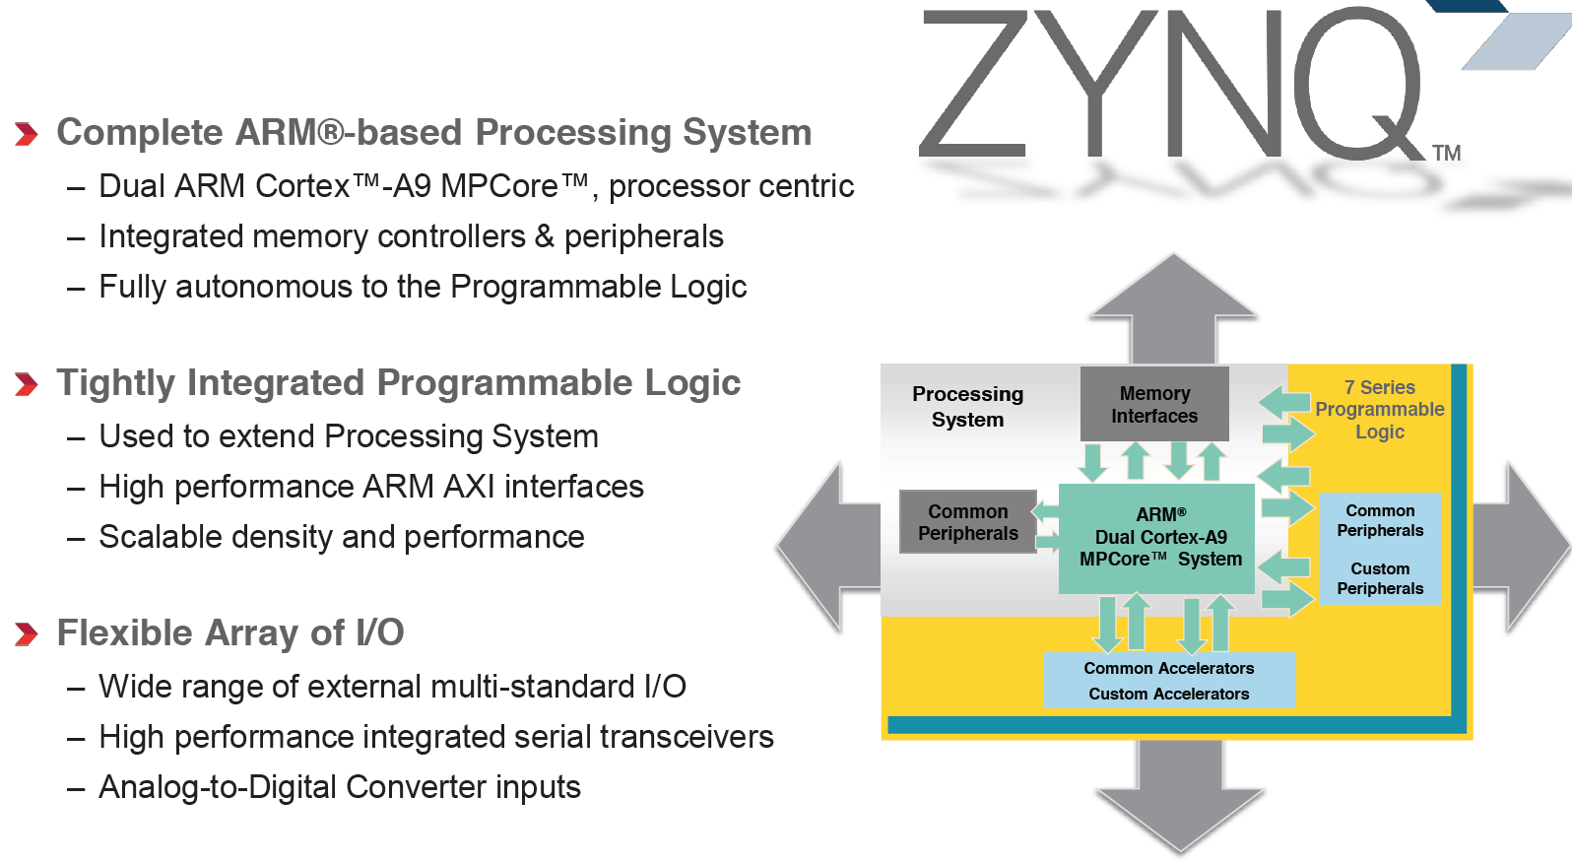
Zynq Highlights
Source: Xilinx Video Tutorials

Slide 23
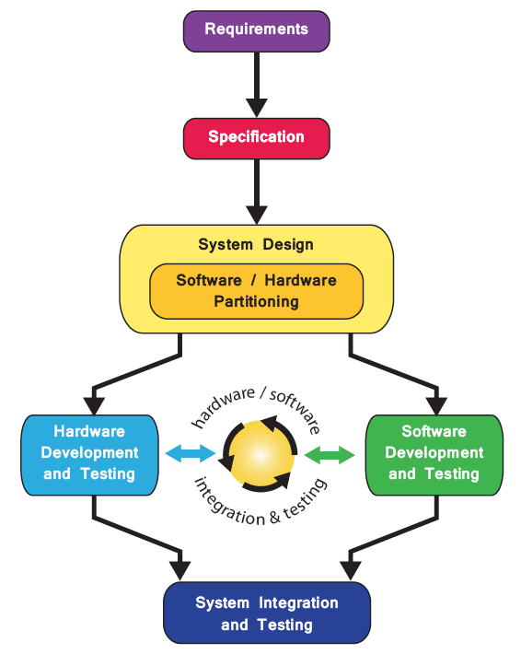
Basic Design Flow for Zynq SoC
Source: the Zynq Book

Slide 24
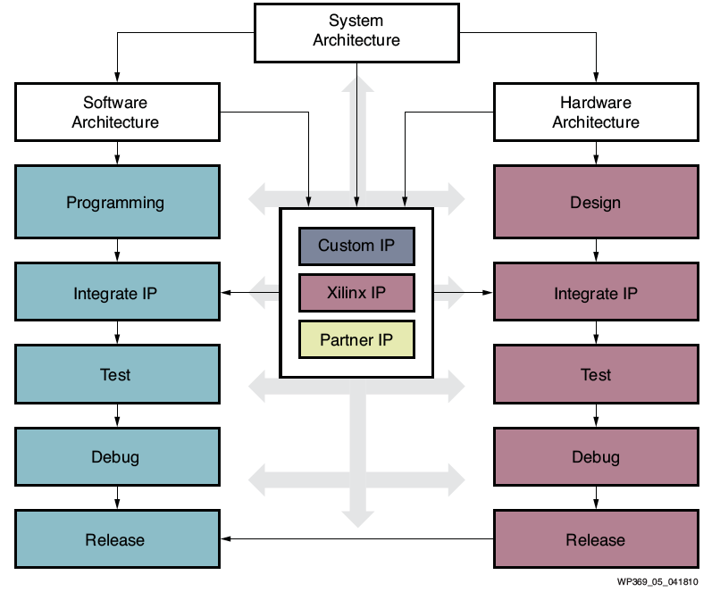
Design Flow for Zynq SoC
Source: Xilinx White Paper: Extensible Processing Platform

Slide 25
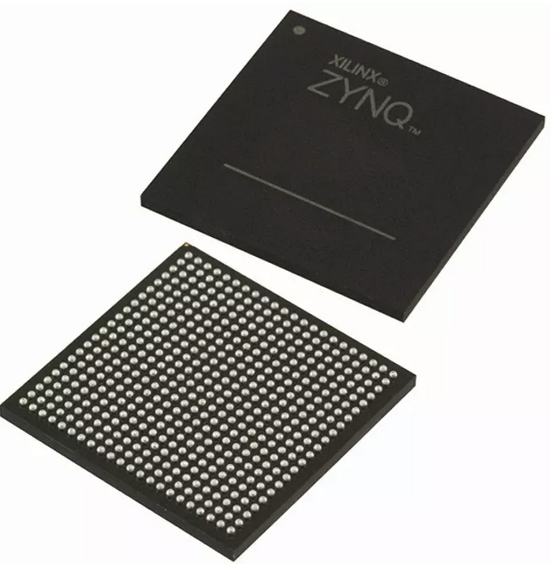
Embedded Design Architecture in Zynq
Processor and peripherals
Dual ARM® Cortex™ -A9 processors of Zynq-7000 AP SoC
AXI interconnect
AXI component peripherals
Reset, clocking, debug ports
Software platform for processing system
Bare Metal Applications or OS’s (e.g. Linux, FreeRTOS)
C language support
Processor services
C drivers for hardware
User application
Interrupt service routines (optional)

Slide 26
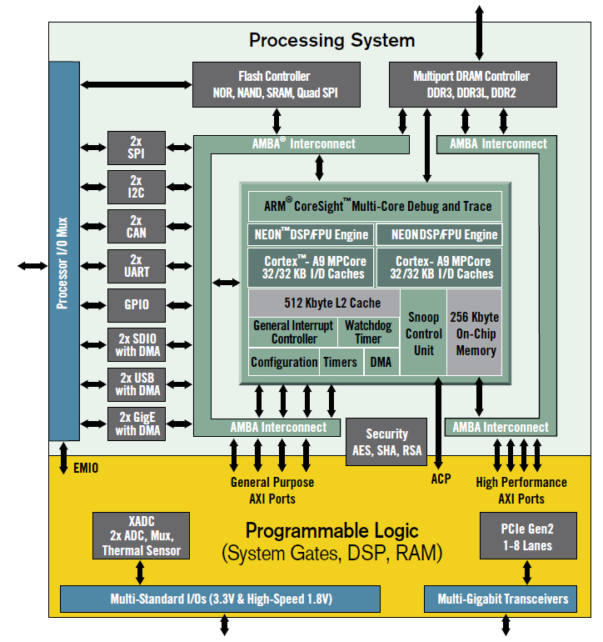
The Zynq-7010 AP SoC Chip Architecture
A 650MHz, dual-core, ARM Cortex-A9 MPCore microprocessor
On-Chip memory controllers
Peripherals
ARM AMBA AXI-based interconnect
Programmable Logic

Slide 27
Zynq-7010 SoC: Processing System and Programmable Logic
Processing System (PS)
Dual-core ARM® Cortex™-A9 MPCore™ with CoreSight™ up to 1GHz
Dynamic Memory interface (DMI): DDR3, DDR3L, DDR2, LPDDR2
High Speed Peripherals: USB 2.0, Gigabit Ethernet, SD/SDIO
Timers: Public and private
General interrupt controller (GIC)
On-chip memory (OCM): ROM and RAM
Debug controller: CoreSight
Programmable Logic (PL)
Max Logic Cells/ System Logic Cells (K): 444
Max Memory (Mb): 26.5
Max DSP Slices: 2,020
Max I/O Pins: 250

Slide 28
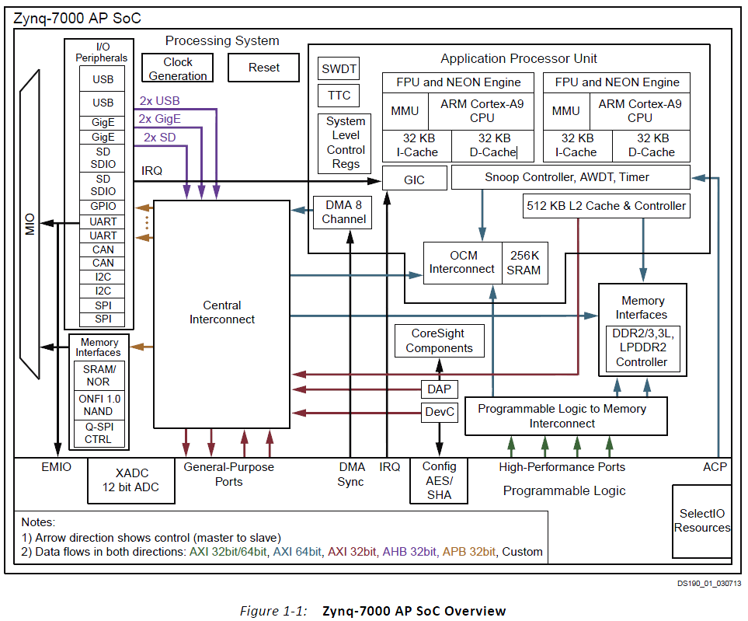
The Zynq AP SoC Processing System
PS
APU
Memory
Peripherals
MIO
PL
Artix®-7
CLBs
BRAM
DSP
XADC
CMT
SelectIO
ug585-Zynq-7000-TRM

Slide 29
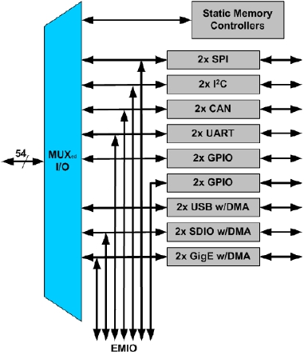
Zynq Architecture Built-in Peripherals
Two USB 2.0 OTG/Device/Host
OTG: On-The-Go
Two Tri- Mode GigE (10/100/1000)
GigE: Gigabit Ethernet
Two SD(Secure Digit) /SDIO interfaces
Memory, I/O and combo cards
Two CAN 2.0Bs, SPIs , I2Cs, UARTs
Four GPIO 32bit Blocks
54 available through MIO; other available through EMIO
Multiplexed Input/Output (MIO)
Multiplexed pinout of peripherals and static memories
Extended MIO (EMIO)
Maps PS peripheral ports to the PL

Slide 30
Processing System (PS): ZYNQ XC7Z010-1CLG400C Chip
ARM Cortex-A9 processor , 650MHz
Single and double precision Vector Floating Point Unit (VFPU)
Timer and Interrupts; Three watchdog timers
One global timer; Two triple-timer counters
Caches
32 KB Level 1 4-way set-associative instruction and data caches
512 KB 8-way set-associative Level 2 cache (shared between the CPUs)
On-Chip Memory
256 KB on-chip RAM (OCM), On-chip boot ROM
External Memory Interfaces
16-bit or 32-bit interfaces to DDR3, DDR3L, DDR2, or LPDDR2 memories
1GB of address space using single rank of 8-, 16-, or 32-bit-wide
8-bit SRAM data bus with up to 64 MB support
ug585-Zynq-7000-TRM

Slide 31
PS: ZYNQ XC7Z010-1CLG400C Chip
I/O Peripherals and Interfaces
Two 10/100/1000 tri-speed Ethernet MAC peripherals with
Two USB 2.0 OTG peripherals• Intel EHCI compliant USB host
Two full CAN 2.0B compliant CAN bus interfaces
Two SD/SDIO 2.0/MMC3.31 compliant controllers
Two full-duplex SPI ports with three peripheral chip selects
Two high-speed UARTs (up to 1 Mb/s)
Two master and slave I2C interfaces
GPIO with four 32-bit banks
up to 54 bits can be used with the PS I/O
up to 64 bits connected to the Programmable Logic
Up to 54 flexible multiplexed I/O (MIO) for peripheral pin assignments
Interconnect
High-bandwidth connectivity within PS and between PS and PL
ARM AMBA® AXI based
ug585-Zynq-7000-TRM

Slide 32
Programmable Logic (PL): Artix-7 FPGA
450MHz Internal Clock
Configurable Logic Blocks (CLB)
28K Logic Cells, 17,600 Look-up tables (LUT); 35,200 Flip-flops; Cascadeable adders
240 Kb Block RAM
80 DSP Blocks
18 x 25 signed multiply; 48-bit adder/accumulator; 25-bit pre-adder
Programmable I/O Blocks
Supports LVCMOS, LVDS, and SSTL; 1.2V to 3.3V I/O
Serial Transceivers
Up to 16 receivers and transmitters; Supports up to 12.5 Gb/s data rates
Two 12-Bit Analog-to-Digital Converters
Up to 17 external differential input channels
One million samples per second maximum conversion rate
ug585-Zynq-7000-TRM

Slide 33
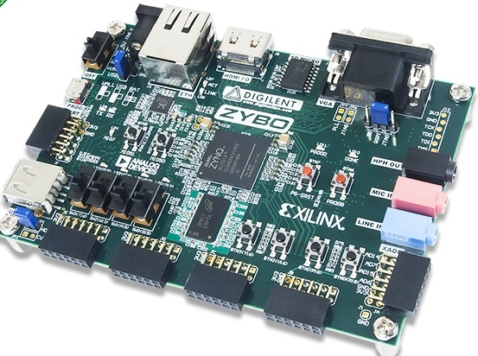
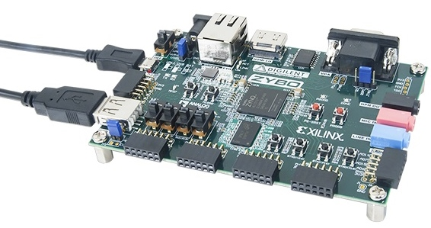
Zybo Zynq-7000 ARM/FPGA SoC Trainer Board, $189
ZYNQ XC7Z010-1CLG400C chip
650Mhz dual-core Cortex-A9 processor
Reprogrammable logic equivalent to Artix-7 FPGA
On-board memories, video and audio I/O, dual-role USB, Ethernet and microSD slot
5V 2.5A switching power supply
6 pushbuttons, 4 slide switches, 5 LEDs
six Pmod connectors
ZYBO Reference Manual

Slide 34
ZYNQ XC7Z010-1CLG400C on Zybo
650Mhz dual-core Cortex-A9 processor
DDR3 memory controller with 8 DMA channels
High-bandwidth peripheral controllers: 1G Ethernet, USB 2.0, SDIO
Low-bandwidth peripheral controller: SPI, UART, CAN, I2C
Reprogrammable logic equivalent to Artix-7 FPGA
4,400 logic slices, each with four 6-input LUTs and 8 flip-flops
240 KB of fast block RAM
Two clock management tiles, each with a phase-locked loop (PLL) and mixed-mode clock manager (MMCM)
80 DSP slices
Internal clock speeds exceeding 450MHz
On-chip analog-to-digital converter (XADC)
ZYBO Reference Manual

Slide 35
Resources on the Zybo
ZYNQ XC7Z010-1CLG400C
512MB x32 DDR3 w/ 1050Mbps bandwidth
Dual-role (Source/Sink) HDMI port
16-bits per pixel VGA source port
Trimode (1Gbit/100Mbit/10Mbit) Ethernet PHY
MicroSD slot (supports Linux file system)
OTG USB 2.0 PHY (supports host and device)
External EEPROM (programmed with 48-bit globally unique EUI-48/64™ compatible identifier)
Audio codec with headphone out, microphone and line in jacks
128Mb Serial Flash w/ QSPI interface
On-board JTAG programming and UART to USB converter
GPIO: 6 pushbuttons, 4 slide switches, 5 LEDs
Six Pmod connectors (1 processor-dedicated, 1 dual analog/digital, 3 high-speed differential, 1 logic-dedicated)
ZYBO Reference Manual

Slide 36
Zynq 7000 Chip on Zybo Board
XC7Z010T-1CLG400 All Programmable SoC
The Zynq-7000 AP SoC architecture consists of two major sections
PS: Processing system
Dual ARM Cortex-A9 processor based
Multiple peripherals
Hard silicon core
PL: Programmable logic
Shares the same 7 series programmable logic as
Artix™-based devices: Z-7010, Z-7015, and Z-7020 (high-range I/O banks only)

Slide 37
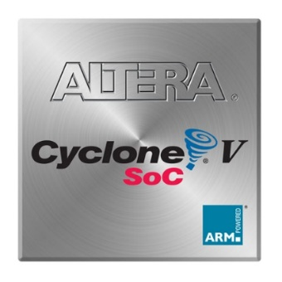
Intel Altera’s Cyclone V SoC Hard Processor System
925 MHz, dual-core ARM® Cortex™-A9 MPCore™ processor
32 KB of L1 instruction cache, 32 KB of L1 data cache
512 KB of shared L2 cache
64 KB of scratch RAM
Multiport SDRAM controller with support for DDR2, DDR3, and LPDDR2 and optional error correction code (ECC) support
8-channel direct memory access (DMA) controller
QSPI flash controller, NAND flash controller with DMA
SD/SDIO/MMC controller with DMA
2x 10/100/1000 Ethernet media access control (MAC) with DMA
2x USB On-The-Go (OTG) controller with DMA
4x I2C controller
2x UART

Slide 38
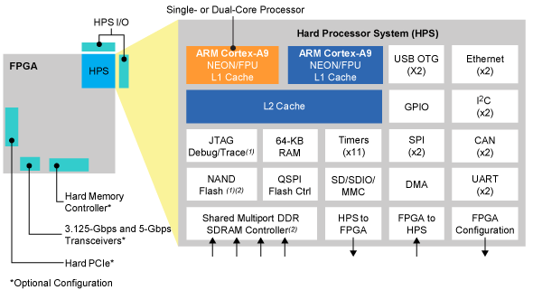
Altera’s Cyclone V SoC Hard Processor System
2x serial peripheral interface (SPI) master peripherals, 2x SPI slave peripherals
Up to 134 general-purpose I/O (GPIO)
7x general-purpose timers
4x watchdog timers

Slide 39
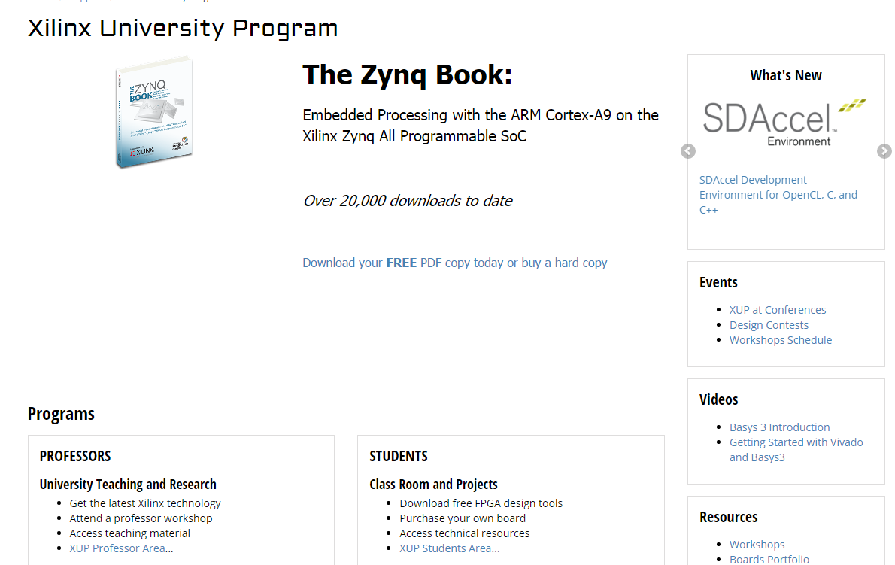
Xilinx University Program: Embedded Systems Development using Zynq
Notes:
The Xilinx University Program (XUP) enables academics to introduce and use Xilinx technologies in their curriculum and research. XUP collaborates with application expert academics to develop and deliver top-quality teaching materials. XUP also develops in-house workshop materials, teaching users how to use the tools and technologies in the most efficient ways. These workshop materials are accessible to academics to use in classes in their original forms and/or extend with additional material. XUP also gets actively involved in research projects where Xilinx FPGA technologies are utilized.

Slide 40
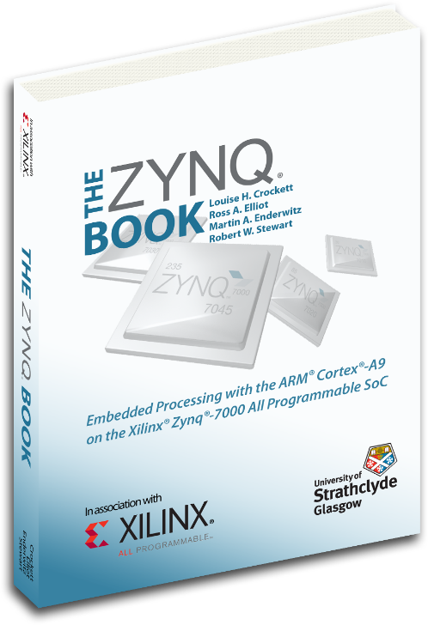
The First Five Labs: Embedded Systems Development using Zynq
From Xilinx University Program Website
Introduction to Embedded System Design using Zynq and Vivado
Lab 1: Simple Hardware Design with Zynq ARM Cores
Lab 2: Adding IPs in Programmable Logic to Add Your Own Peripheral
Lab 3: Creating and Adding Custom IP
Software Development Environment
Lab 4: Writing Basic Software Applications
Software Development and Debugging
Lab 5: Software Debugging Using SDK

Slide 41
ARM Cortex-A9 based Embedded System Design: Lab1 through Lab5
Lab #3 of this class: ZYNQ Labs 1 and 2
Lab #4 of this class: ZYNQ Labs 3 and 4
Lab #5 of this class: ZYNQ Lab 5
Lab4 uses hardware built in Lab3
DDR3
Memory
Controller
ARM
Cortex-A9
PL
Memory
Timer
RS232
UART
AXI
Interconnect
Block
AXI4
AXI-BRAM Controller
BRAM
AXI4-Lite
LED_IP
LED
M_AXI_GP0
AXI4-Lite
GPIO
Push-Buttons
PS
AXI4-Lite
GPIO
DIP Switches
Lab1
Lab2
Lab3
Lab5
© Copyright 2015 Xilinx

Slide 42
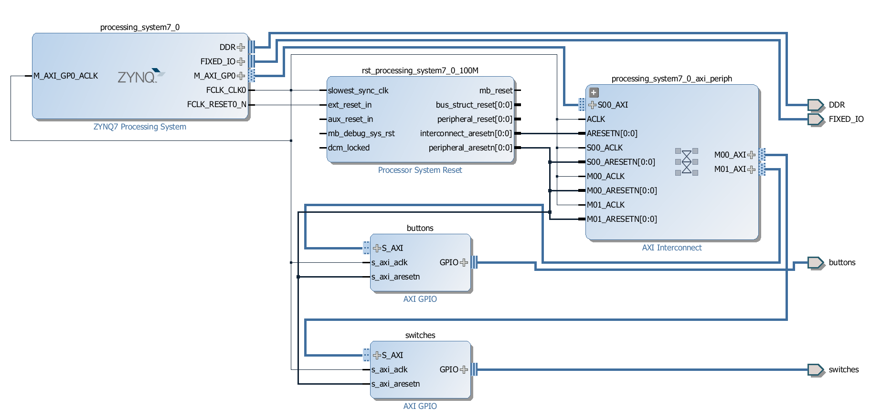
Lab #3 Part 1 and Part 2: Build a System and Add Soft IP Cores in PL
Lab #3 Part 1: ZYNQ Lab 1 Use Vivado to Build Embedded Systems, pages ZYNQ1-1 to ZYNQ1-16.
Lab #3 Part 2: ZYNQ Lab 2 Adding IP Cores in PL, pages ZYNQ2-1 to ZYNQ2-16.
AXI crossbar
switch soft cores
ARM hard core
EMIO pins
AXI interconnect
soft core
AXI interconnect
soft core
EMIO pins

Slide 43
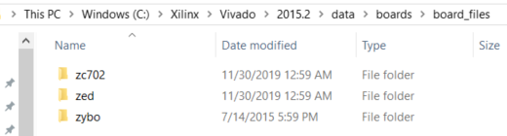
Lab #3 Part 1 (ZYNQ 1) Use Vivado to Build an ARM Embedded System
Lab #1: ZYNQ Lab 1 Use Vivado to Build Embedded Systems, pages ZYNQ1-1 to ZYNQ1-16.
Create a Vivado project for z Zynq system
Use the IP integrator to create an ARM hardware system
Use Software Development Kit (SDK) to create a standard memory test project
Run the memory test program on Zybo board
Choose Zybo Board Interface File

Slide 44
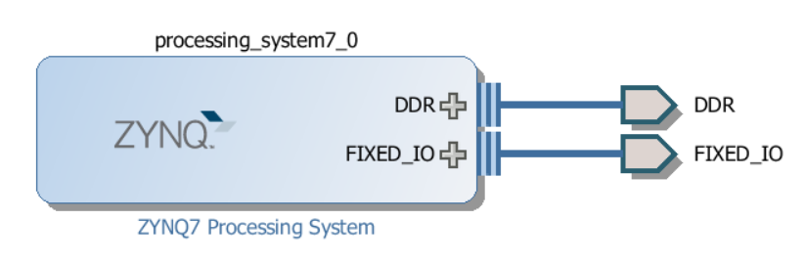

Lab #3 Part 1 (ZYNQ 1) Use Vivado to Build an ARM Embedded System
Lab #1: ZYNQ Lab 1 Use Vivado to Build Embedded Systems, pages ZYNQ1-1 to ZYNQ1-16.
Create a Vivado project for z Zynq system
Use the IP integrator to create an ARM hardware system
Use Software Development Kit (SDK) to create a standard memory test project
Run the memory test program on Zybo board
ARM Core CPU and DDR4 Memory Test
512MB x32 DDR3 w/ 1050Mbps bandwidth
DDR3 memory interface
ARM hard core

Slide 45
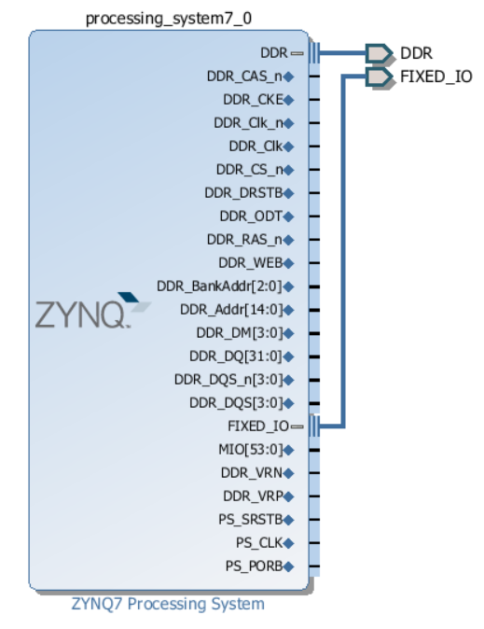
ARM hard core
DDR3 memory interface

Slide 46
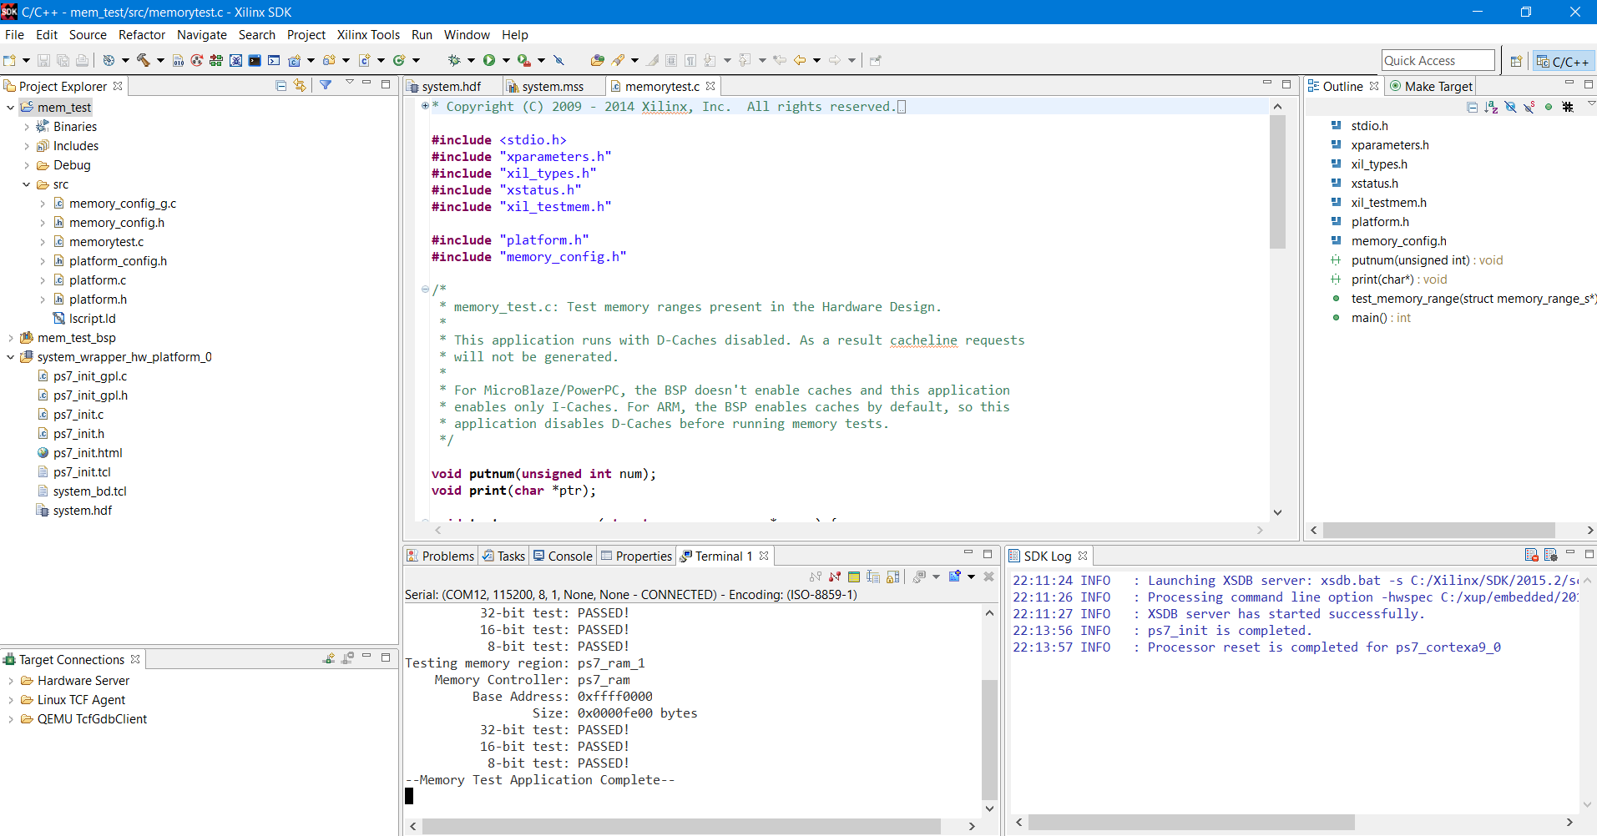

Lab #3 Part 1 (ZYNQ 1) SDK and Complete Display
Software Development Kit (SDK)
--Memory Test Application Complete--

